Slide 1
Sem III- ZOOACOR05T- UNIT-5 Parental Care in Fishes(Part 1)
Dr. Barnali Manna
Deptt of Zoology
Sarojini Naidu College for Women

Slide 3
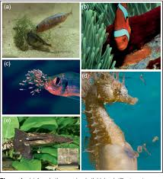
What is parental care??
Parental care is an inborn instinctive behaviour shown by different species of fish.
Parental care is evolved in those organism which produce limited number of eggs to ensure the continuity of their race.

Slide 4
Why parental care?
Increase offspring survival
Improve offspring growth rate and quality
Directly increase offspring reproductive fitness.
Perpetuation of race.

Slide 5
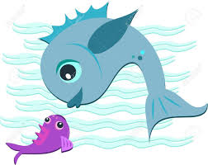
Maternal care: provided by the mother alone.
viviparity is a remarkable example of maternal care.

Slide 6
In contrast to other animals,in fish,it is the males that usually provide care.
Biparental care: care is provided by both parents together or in sequences.
Ratio of fish genera that exhibit male only:biparental: female only care = 9:3:1

Slide 7
Cost & Benefits of Parental care
3 main costs :
Decreased parental survival
Increased time until the next breeding attempt
Reduced future fecundity
Benefits
It improves survival and development of young ones.

Slide 8
Diversity and types of parental care
A. Deposition of eggs in suitable places.
B. Deposition of eggs into self-made nest.
C. Hiding or concealing eggs & young ones in or into their body .
D. Viviparity.
E. Care of independently swimming young’s.

Slide 9
Deposition of eggs in suitable places
1.Deposition of eggs in sticky covering
2.eggs scattered over aquatic plant
3.eggs layed in pits
4.eggs layed on dead shells of bivalves

Slide 10
Deposition of Eggs in Sticky covering
In carps(common carp) eggs are usually laid with some special sticky covering by which they are attached with each other or to stones ,weeds etc.
In yellow perch(Perca flavescens) eggs are deposited in a rope like structure.The eggs are held together by a long floating membrane.

Slide 11
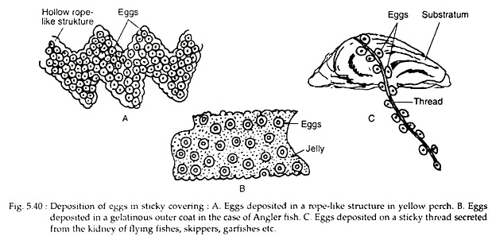

Slide 12
Eggs scattered over Aquatic Plants
Eggs of fishes such as pikes (Esox lucius), carps (Cyprinus carpio), Carrassius auratus etc., are scattered over aquatic plants to which they remain attached.

Slide 13
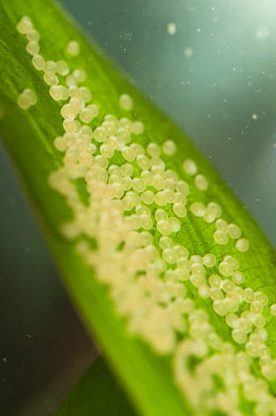

Slide 14
Eggs layed in pits:
Anadromous fishes (lives in the sea but migrates to fresh water for breeding) such as Salmo solar, Acipenser, Oncorhyncus etc., lay their eggs in suitable spawning grounds. They dig excavation in gravel substrate, lay their eggs in the pits, cover them with gravel and desert them.
Sand Gobi (Pomatoschistos minutus) lay their eggs in some protected place,guarded by male who also aerate them.

Slide 15
Eggs scattered on dead shells of bivalves
Females(cyprinid family) deposit their eggs on the dead shells of mussels
Females of european bitterling (Rhodeus amarus) deposit eggs in the siphon of a mussel by means of a long tube drawn out from the oviduct.After oviposition male fish immediately sheds the sperms over the eggs and guards them.

Slide 16
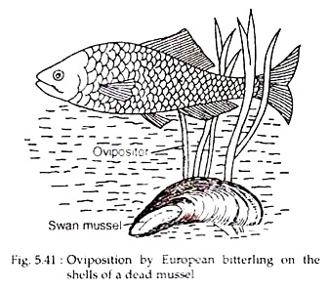

Slide 17
OVIPARY, OVOVIVIPARY, VIVIPARY
these terms used to describe what happens when future offspring separates from parent
OVIPARY – eggs are released and develop outside body of female, fertilisation internal or external, egg yolk only nutrition.Eg.almost all fishes.
OVOVIVIPARY – Internal fertilisation, egg shell soft, eggs hatch inside body, appears to be born alive, egg yolk nutrition,without placental attachment, mother for protection.Eg Sharks,Skates,Ray etc.
VIVIPARY – fertilisation internal, no egg shell, nutrition via placenta. Eg. Poecilia reticulata

Slide 18
OVOVIVIPARY – how is reproduction maximised?
Fewer eggs needed –
higher survival rate of offspring.
Developing embryo much less vulnerable to predators.
Developing embryo not subject to environmental changes e.g. temperature.
Young born fully developed, can feed and escape predators more easily.
Occurs in some invertebrates, fish and reptiles.

Slide 19
VIVIPARY maximising reproduction
Occurs in placental mammals, some sharks (Scoliodon)
Fertilisation internal,
no shell.
Placenta responsible for nutrition –
young born alive
fewer eggs necessary
2. energy available for nourishment and protection of embryo, as well as parental care

